Slide 1
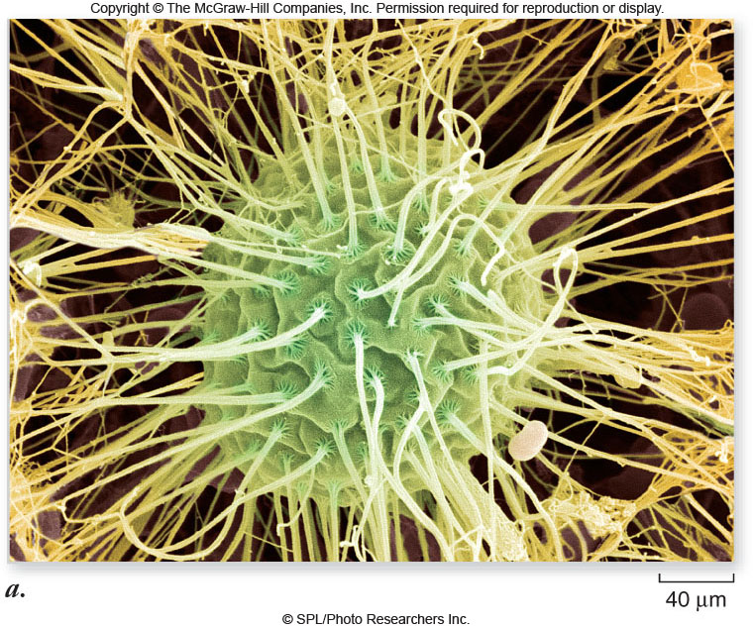
Cell Structure
Chapter 6

Slide 2
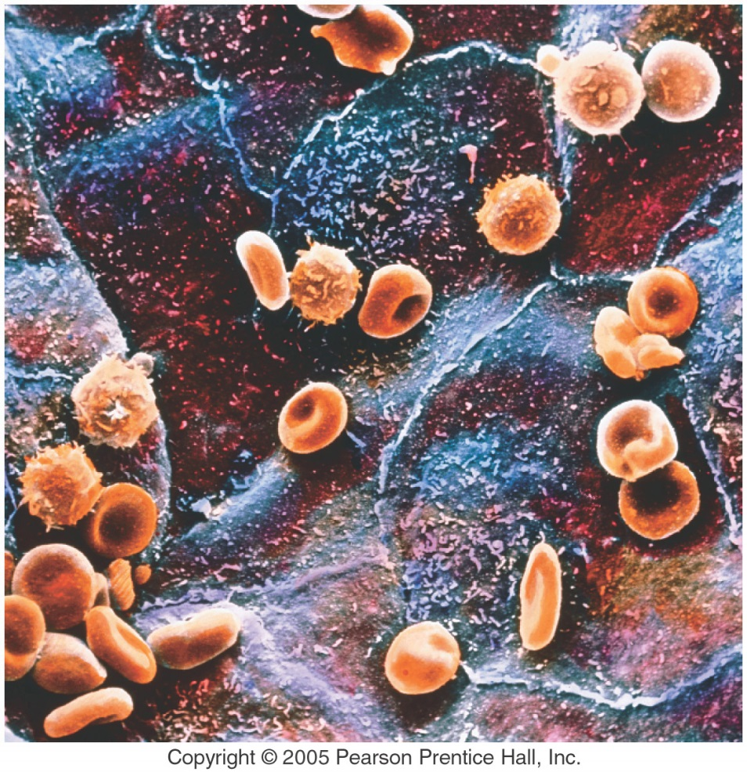
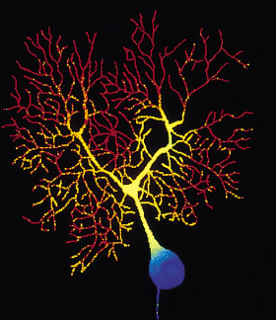
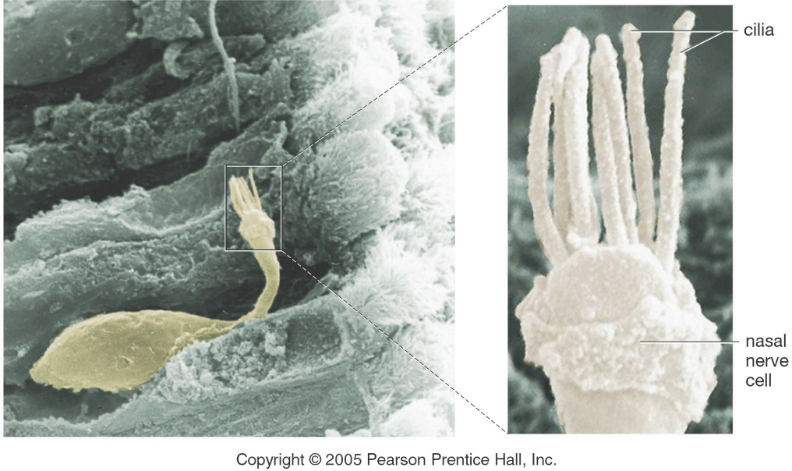
Cells are Us
A person contains about 100 trillion cells. That’s 100,000,000,000,000 or 1 x 10¹⁴ cells.
There are about 200 different cell types in mammals (one of us).
Cells are tiny, measuring on average about 0.002 cm (20 um) across. That’s about 1250 cells, “shoulder-to-shoulder” per inch.
Red and white blood cells above vessel-forming cells.
nerve cell

Slide 3
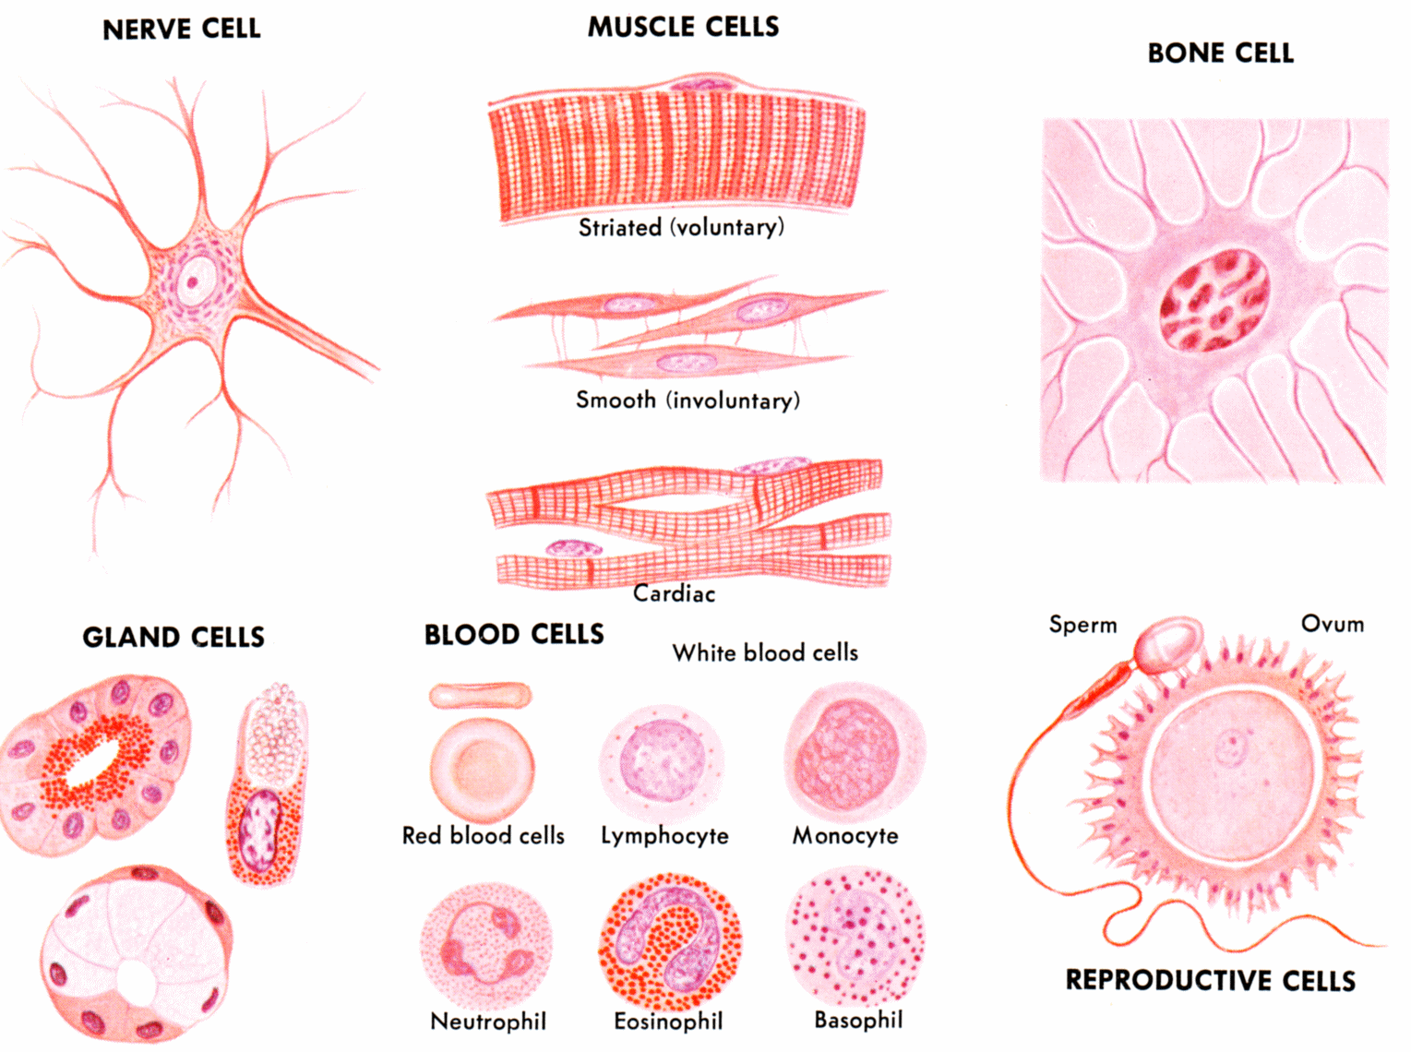
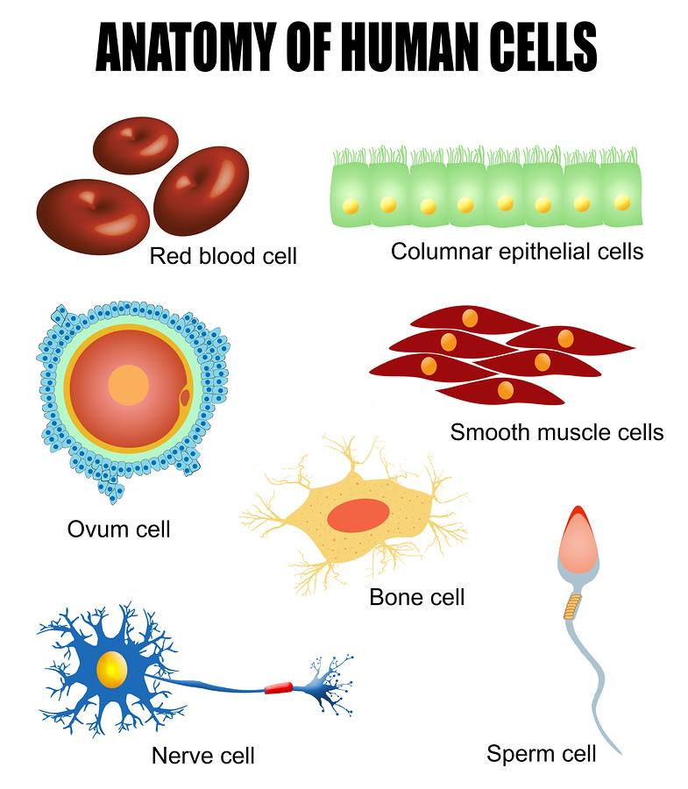
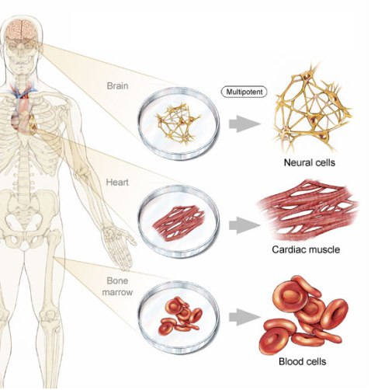

Slide 4
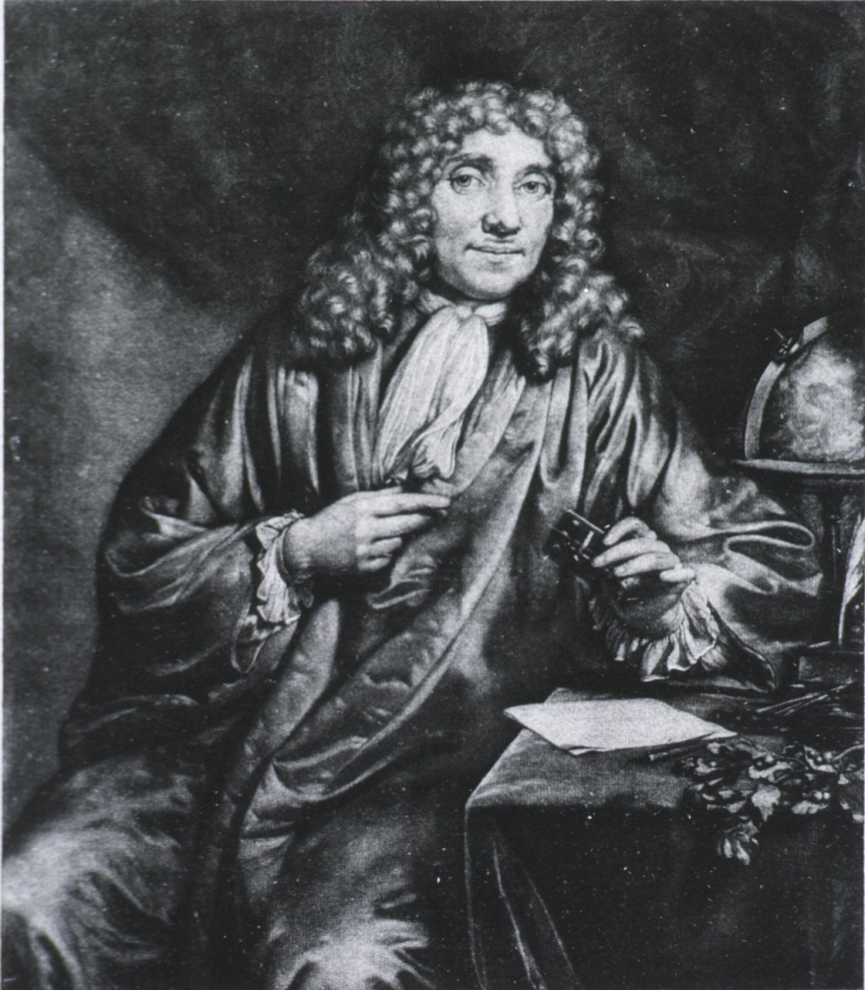
Cell Theory
The Cell is the basic unit of structure and function of living things.
The first major use of the microscope was by Anton von Leeuwenhoek.
Dutch Biologist who observed the first microbes while looking at a sample of pond water.
He called them “Wee Beasties”.

Slide 5
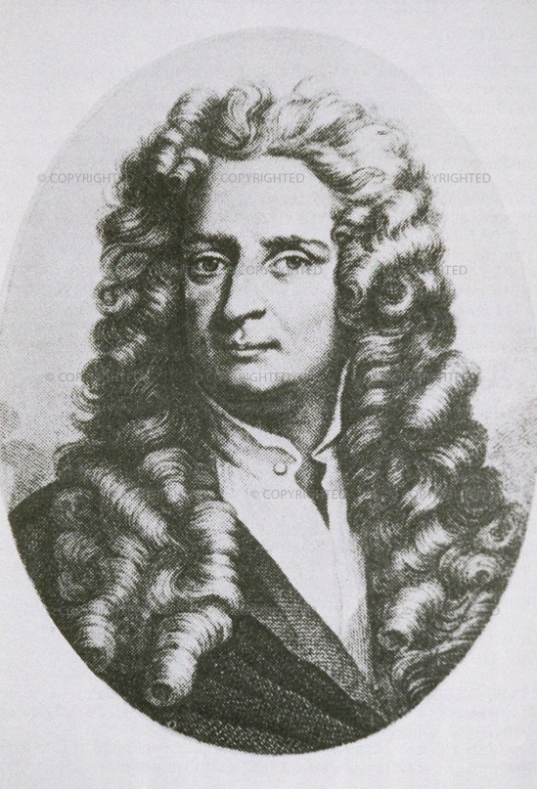
Cell Theory
Cells were discovered in 1665 by Robert Hooke.
He was inspired by Leeuwenhoek and began looking at multicellular organisms.
Early studies of cells were conducted by
- Mathias Schleiden (1838) - plants
- Theodor Schwann (1839) - animals
- Rudolf Virchow (1840) – cells from other cells

Slide 6
Cell Theory
C. Robert Brown: Discovered the nucleus of the cell. (1831)

Slide 7
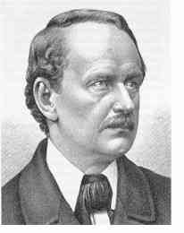
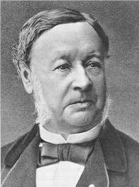
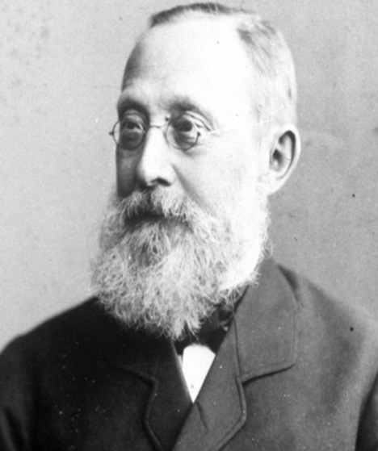
The Cell Theory
The cell theory (proposed independently in 1838 and 1839) is a cornerstone of biology.
All organisms are composed of one or more cells.
Schleiden
Cells are the smallest living things.
Cells arise only by division of previously existing cells.
All organisms living today are descendents of an ancestral cell.
Schwann
Virchow

Slide 8
Cell Theory
Cell Theory
1. All organisms are composed of cells.
2. Cells are the smallest living things.
3. Cells arise only from pre-existing cells.
All cells today represent a continuous line of descent from the first living cells.

Slide 9
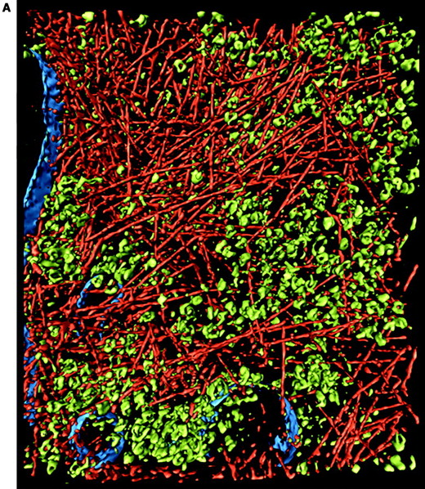
It’s Crowded In There
A micrograph showing cytoskeleton (red), ribosomes (green), and membrane (blue)

Slide 10
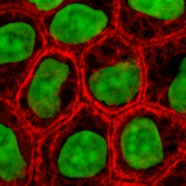

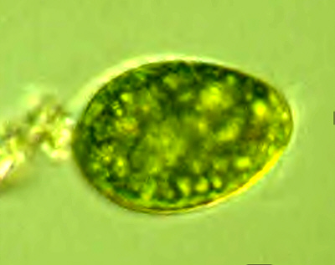
What Do Cells Need to Do Every Day?
Cells need to build proteins
Cells need energy
Cells need to make more cells

Slide 11
How does the Nucleus Control the Cell’s Activities?
The Nucleus is like the “brain” of the cell—controlling most of the activities of the cell. How does it do this? By controlling what proteins are made.
Proteins are the workhorse molecules of the cell—they are made by ribosomes.
The nucleus contains the following organelles that are needed for protein synthesis:
Nucleolus—builds rRNA and Ribosomes
Chromosomes/Chromatin—contains strands of DNA
Nuclear Membrane—has pores to allow mRNA to leave nucleus and go to ribosomes

Slide 12
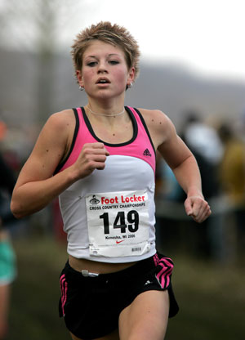
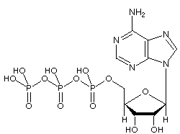
Cells Need Energy
Take in nutrients
Take in oxygen
Build cell structures
Remove wastes
Make ATP
Cells use many organelles to obtain, store, and release energy: plasma membrane, ER, Golgi Apparatus, Lysosomes, Mitochondria and Chloroplasts
ATP

Slide 13
Cell size
Cell size is limited.
-As cell size increases, it takes longer for material to diffuse from the cell membrane to the interior of the cell.
Surface area-to-volume ratio: as a cell increases in size, the volume increases 10x faster than the surface area

Slide 14
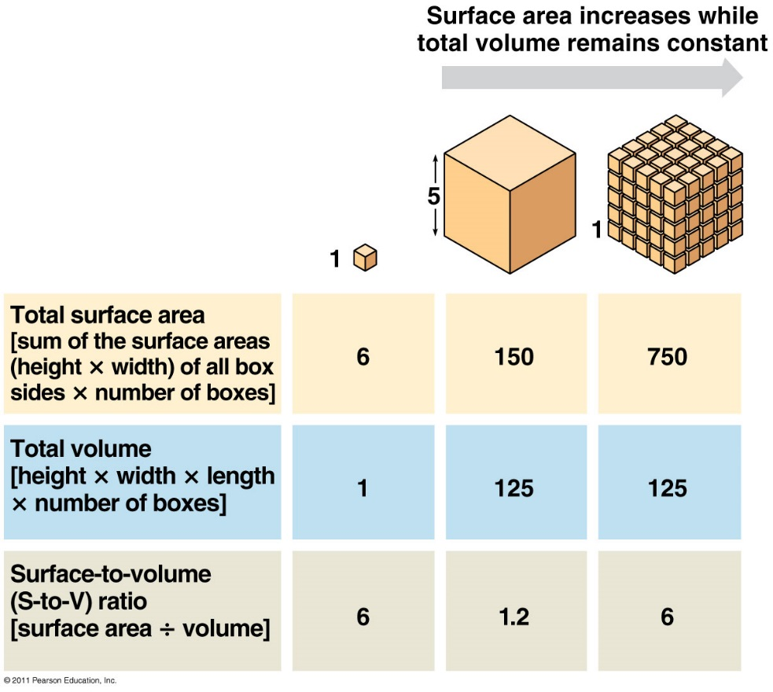
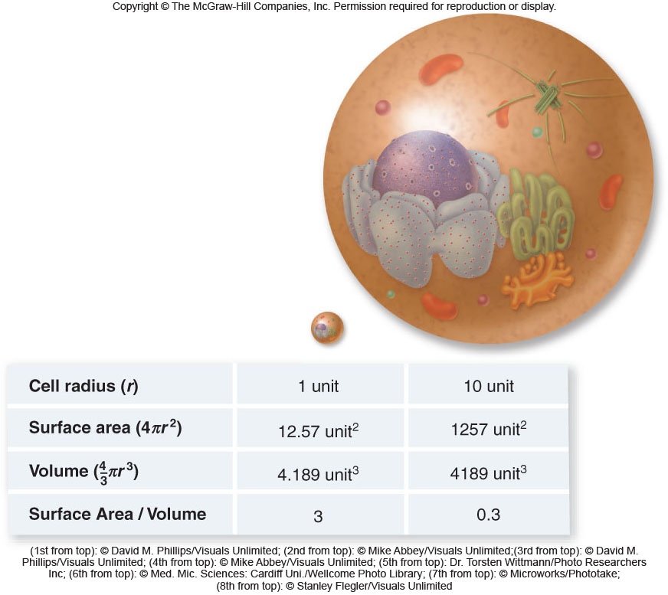
Cells must be small to maintain a large surface area to volume ratio
Large S.A. allows ↑ rates of chemical exchange between cell and environment
http://learn.genetics.utah.edu/content/begin/cells/scale/
Scale of the Universe:
http://www.onemorelevel.com/game/scale_of_the_universe_2012

Slide 15
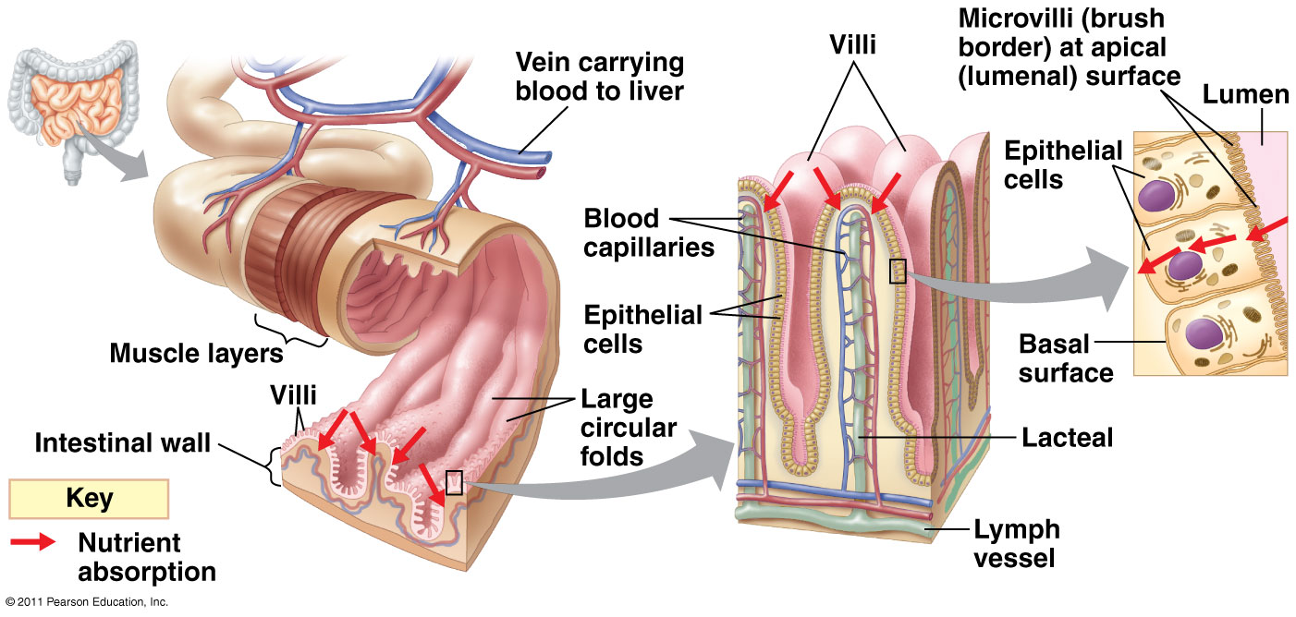
Surface Area Example (Animal):
Small Intestine: highly folded surface to increase absorption of nutrients
  Villi: finger-like projections on SI wall
  Microvilli: projections on each cell

Slide 16
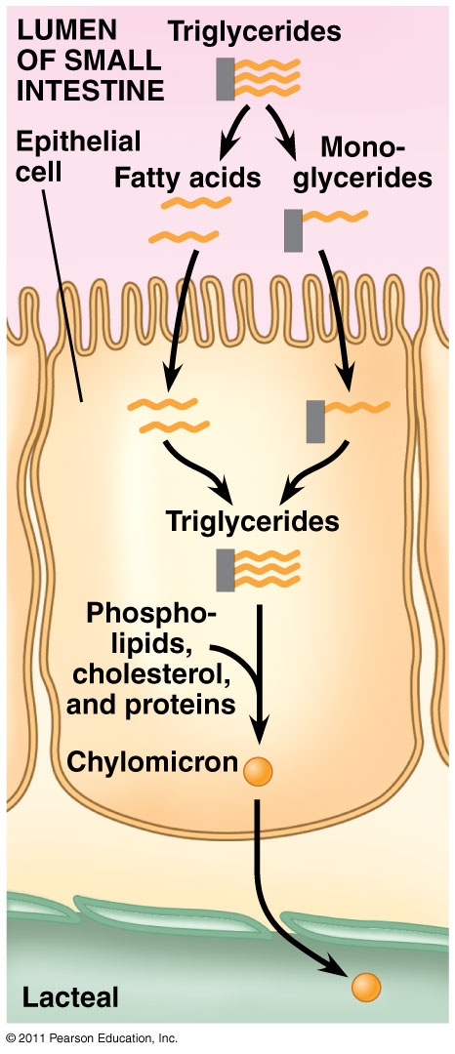
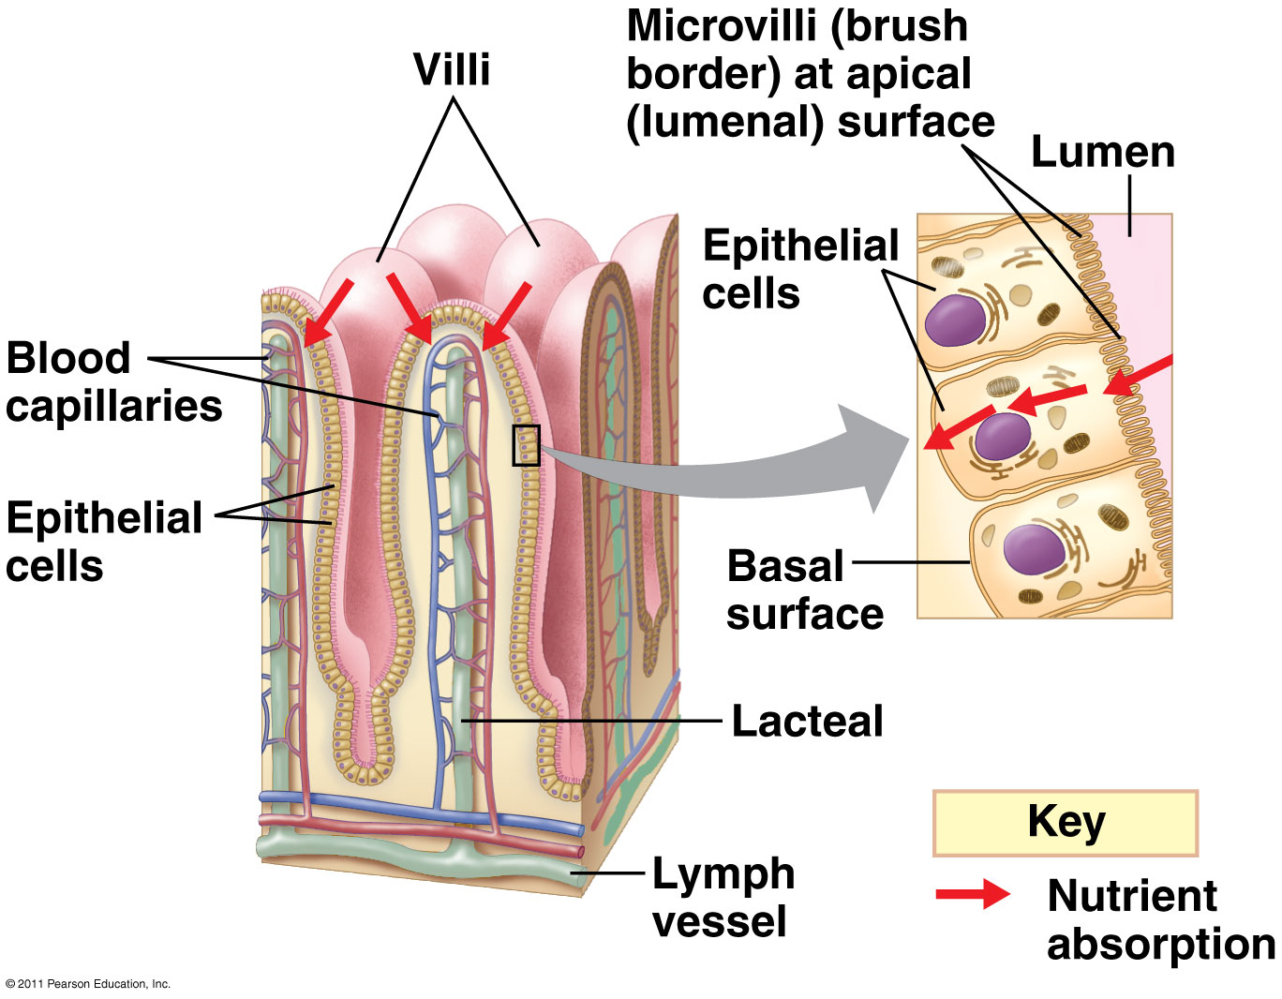
Folds → Villi → Microvilli

Slide 17
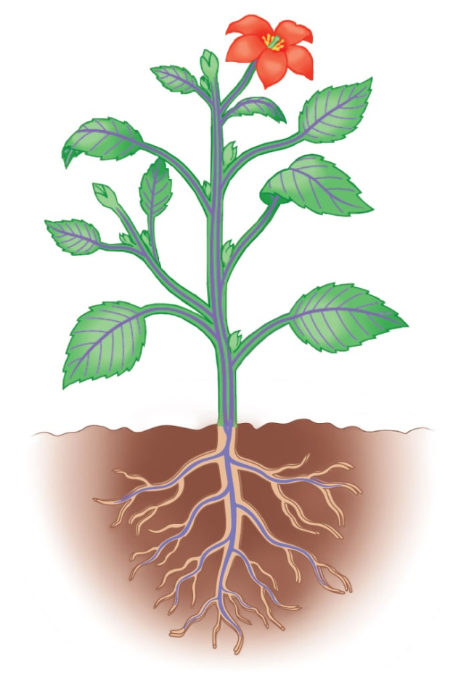
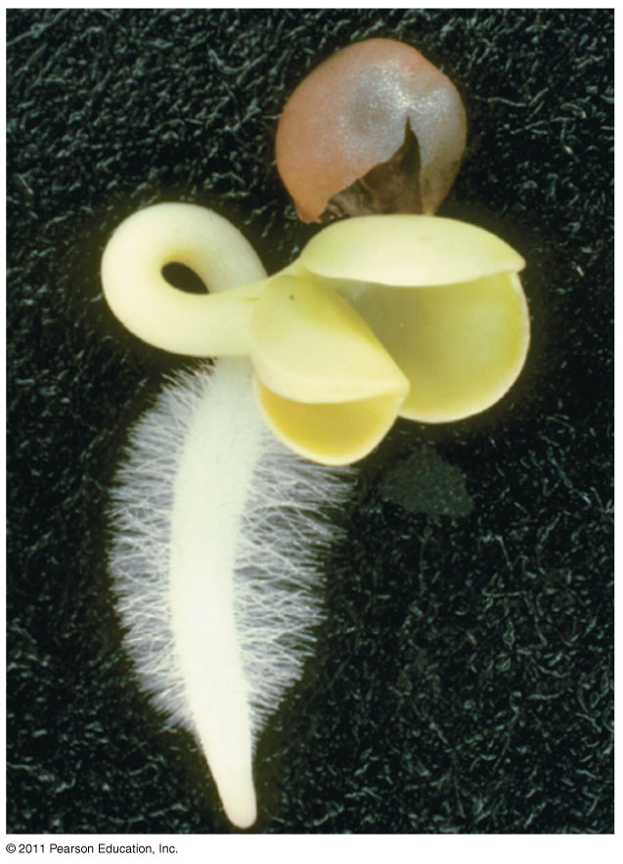
Surface Area Example (Plant):
Root hairs: extensions of root epidermal cells; increase surface area for absorbing water and minerals

Slide 18
Cell Theory
All cells have certain structures in common.
1. genetic material – in a nucleoid or nucleus
2. cytoplasm – a semifluid matrix
3. plasma membrane – a phospholipid bilayer
4. ribosomes

Slide 19
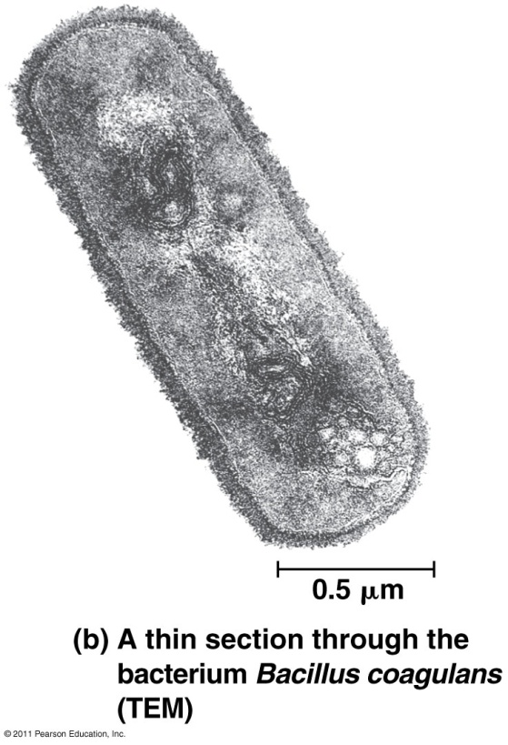
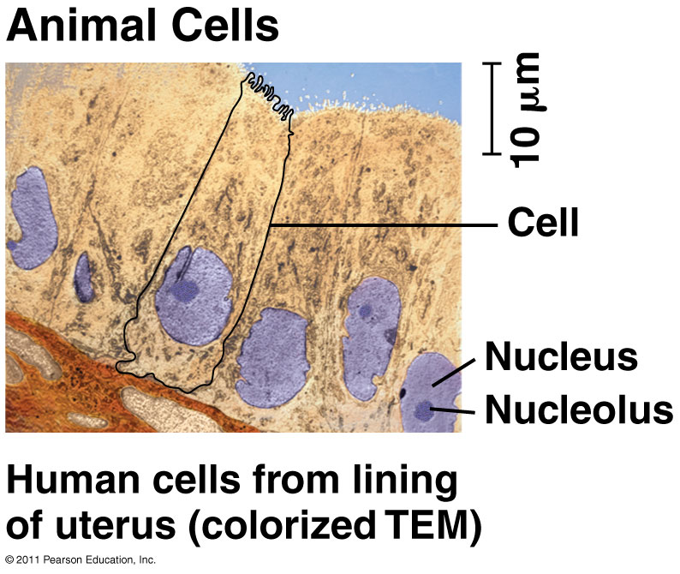
2 Types of Cells:
Prokaryotes: Domain Bacteria & Archaea
Eukaryotes (Domain Eukarya): Protists, Fungi, Plants, Animals

Slide 20
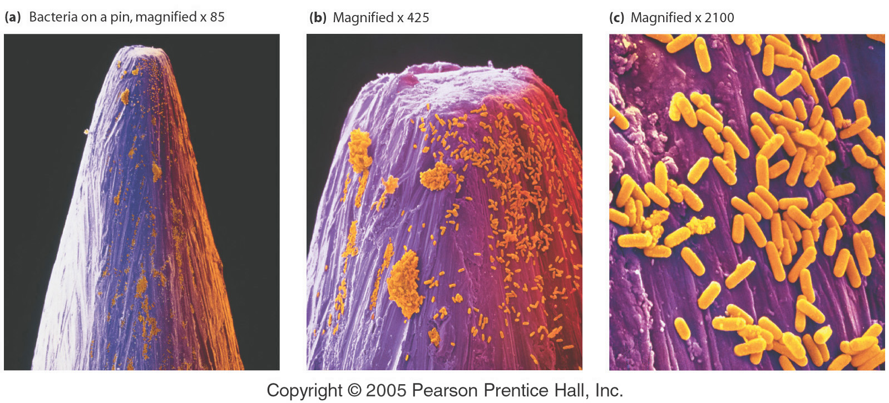
A Sense of Scale and Abundance – Bacteria on the Head of a Pin

Slide 21
Prokaryotic Cells
“before” “kernel”
Prokaryotic cells possess
genetic material in the nucleoid (No nucleus)
cytoplasm/Cytosol
plasma membrane
cell wall
No organelles other than ribosomes
no membrane-bound organelles
Small size
Primitive

Slide 22
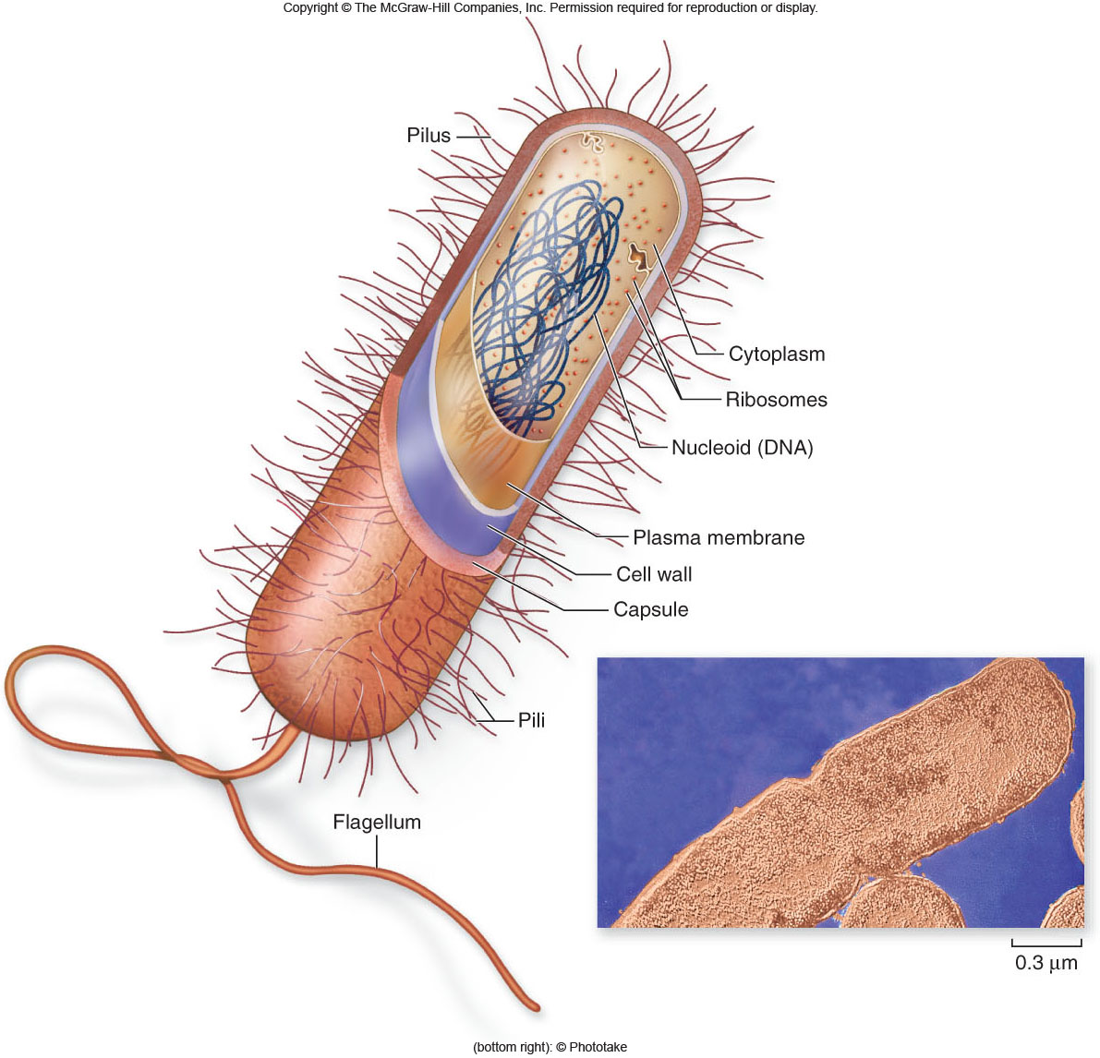
Prokaryotic Cells

Slide 23
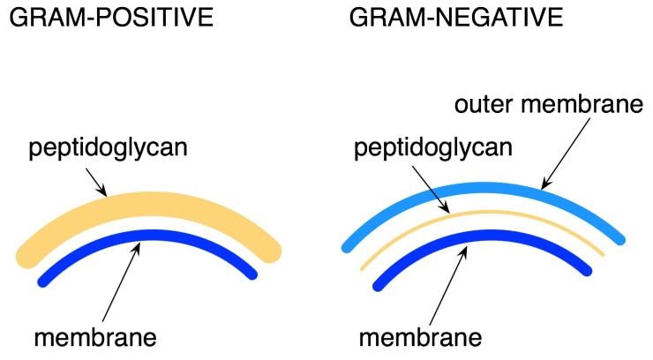
Prokaryotic Cells
Prokaryotic cell walls
protect the cell and maintain cell shape
may be composed of peptidoglycan
  Complex polysaccharide
may be Gram positive or Gram negative
  Gram Positive react to antibiotics
  Gram Negative Bacteria do not
Archaean cell walls lack peptidoglycan.

Slide 24
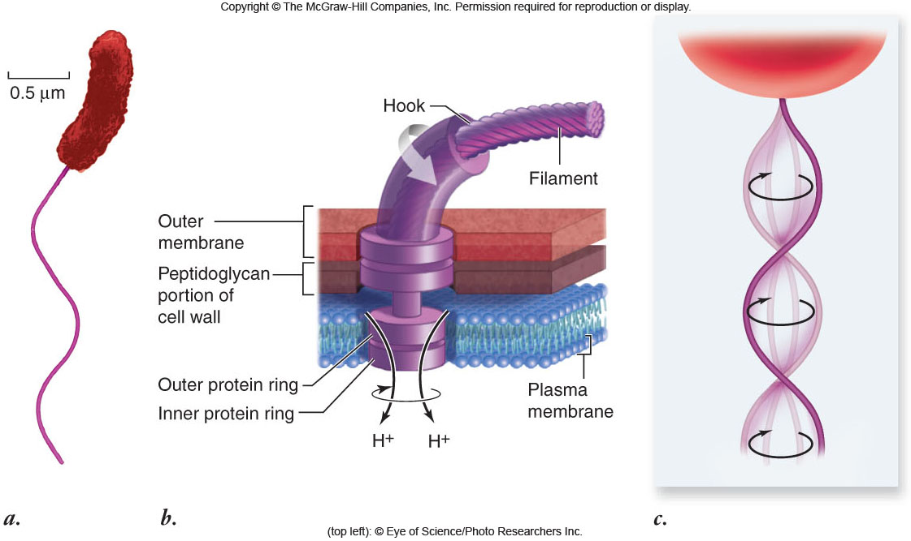
Prokaryotic Cells
Flagella
present in some prokaryotic cells
used for locomotion
rotary motion propels the cell

Slide 25
Eukaryotic Cells
“true” “kernel”
Eukaryotic cells
possess a membrane-bound nucleus
  other membrane bound organelles with specialized structure/function
are more complex than prokaryotic cells
compartmentalize
  many cellular functions within organelles and the endomembrane system
cytoskeleton for support and maintain cellular structure

Slide 26
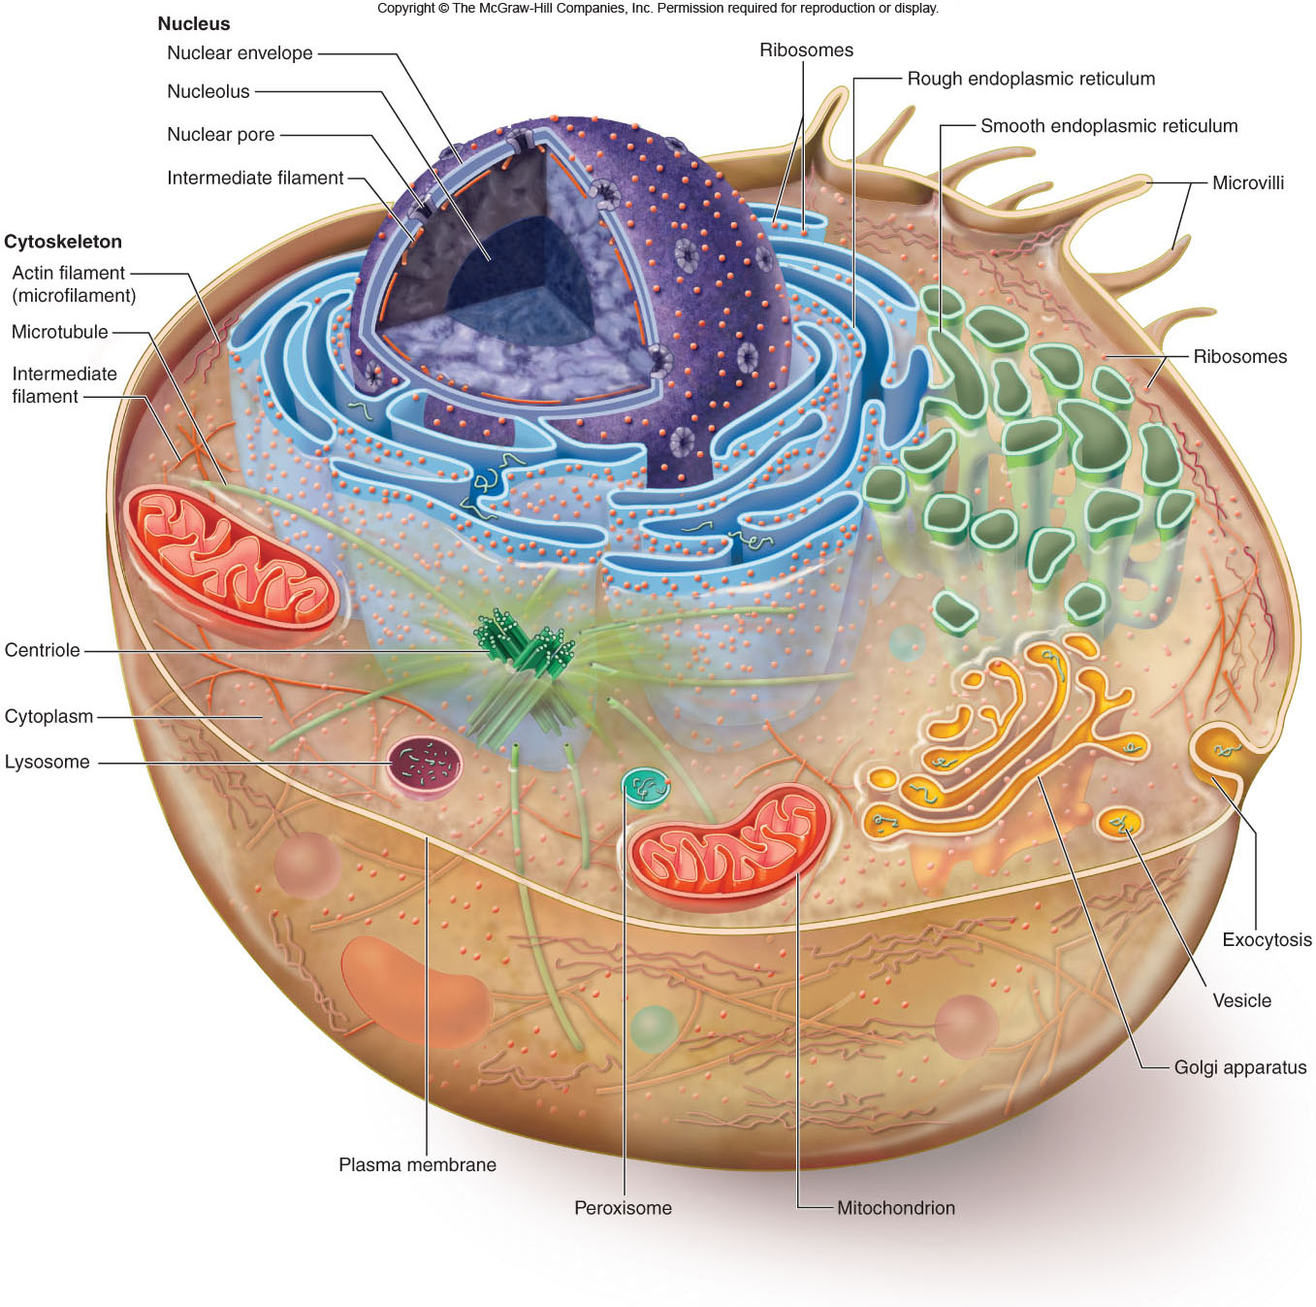
Eukaryotic Cells

Slide 27
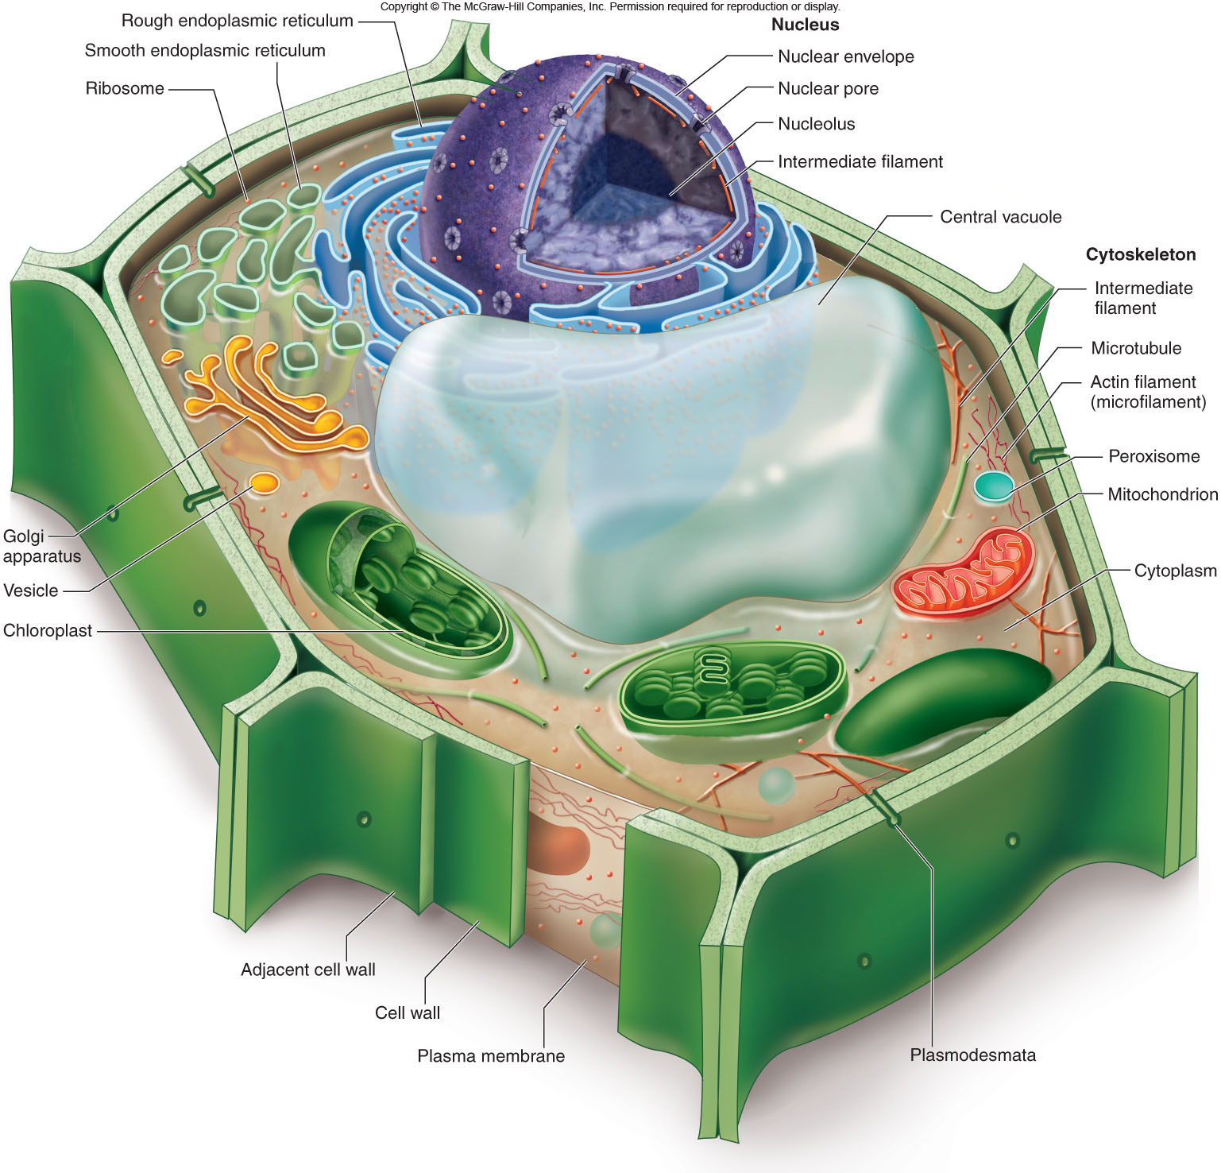
Eukaryotic Cells

Slide 28
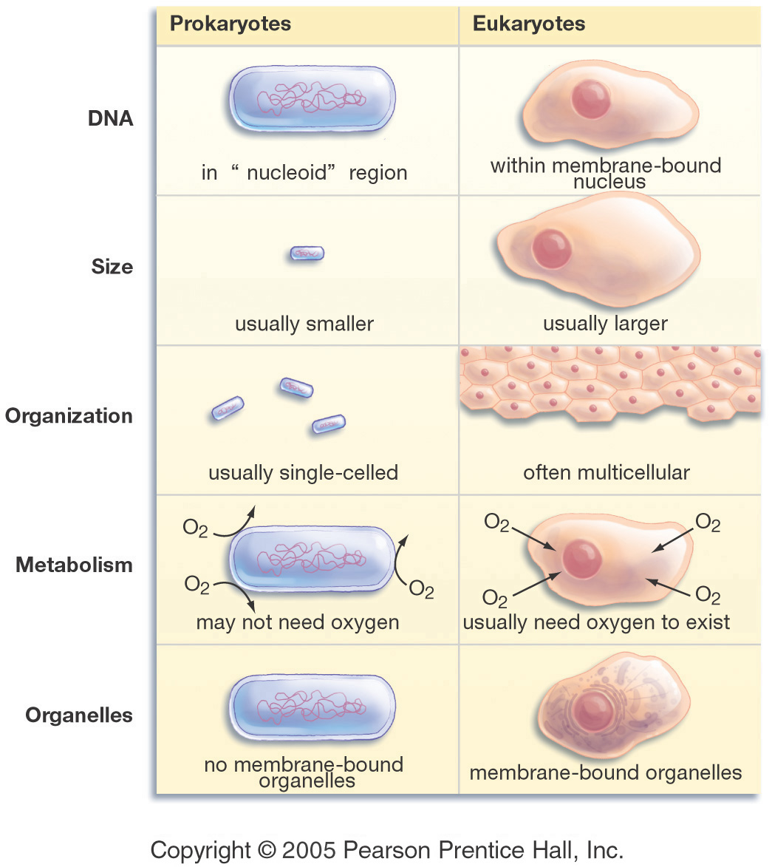
Us vs. Them -Eukaryotes and Prokaryotes

Slide 29
Nucleus
Function: control center of cell
Contains DNA
  multiple, linear chromosomes
  Chromatin: complex of DNA + proteins; makes up chromosomes
Surrounded by double membrane (nuclear envelope)
  composed of 2 phospholipid bilayers
  Continuous with the rough ER
Nuclear pores: control what enters/leaves nucleus
Nucleolus: region where ribosomal subunits are formed

Slide 30
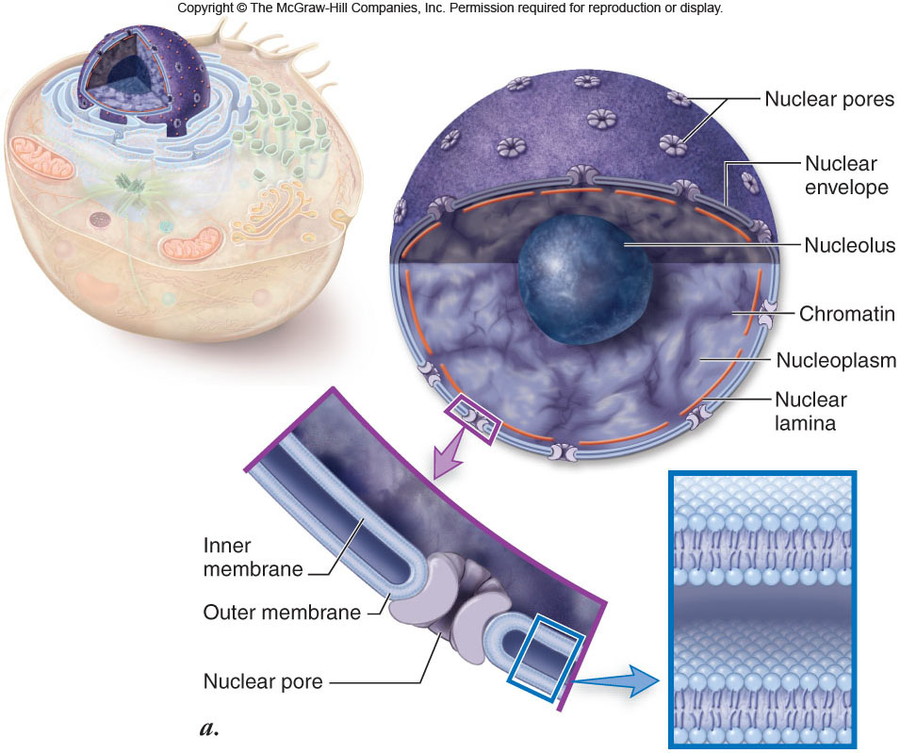

Slide 31
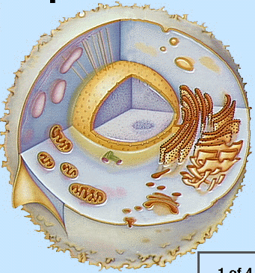
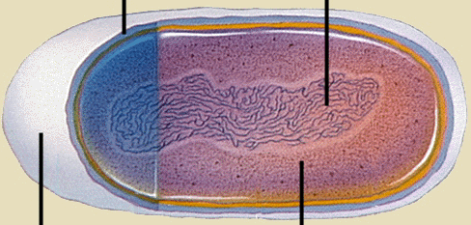
Two Fundamentally Different Types of Cells
A prokaryotic cell
A eukaryotic cell

Slide 32
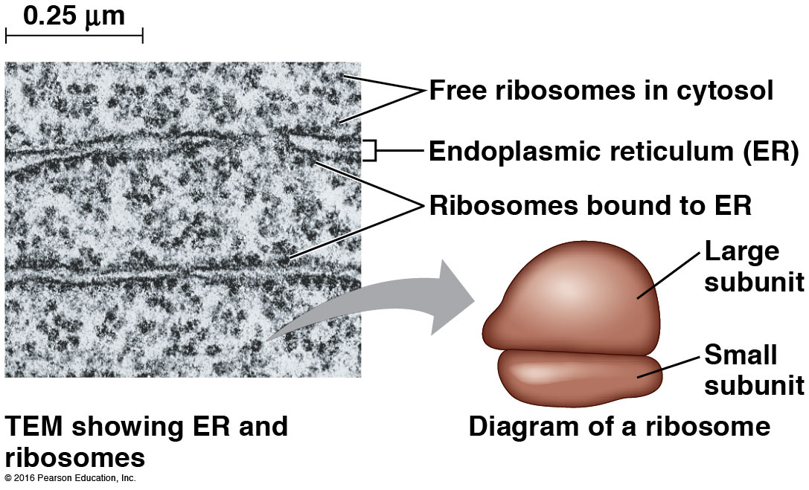
Ribosomes
Function: the site of protein synthesis in the cell
composed of ribosomal RNA (rRNA) and proteins
  Large subunit + small subunit

Slide 33
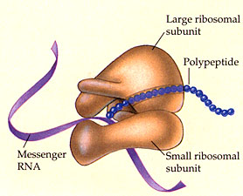
Ribosome
Site of protein synthesis
Types:
  Free ribosomes: float in cytosol, produce proteins used within cell
  Bound ribosomes: attached to ER, make proteins for export from cell
Produced in a part of the nucleus called the nucleolus
That looks familiar…what is a polypeptide?
Notes:
A polypeptide is a chain of amino acids. In this diagram, you can see the ribosome is making a polypeptide, also known as a protein.

Slide 34
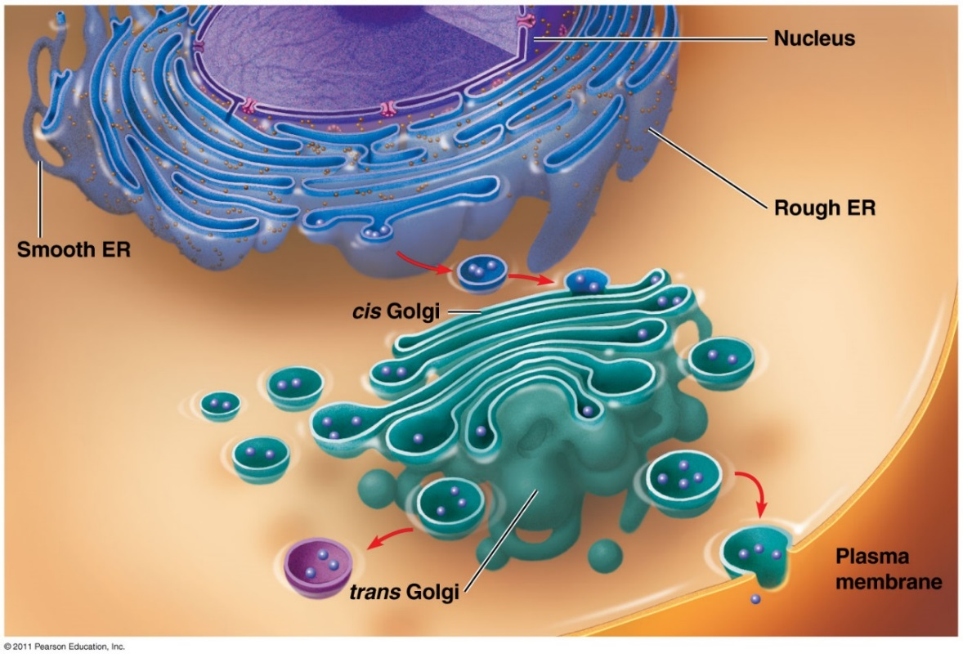
Endomembrane System
a series of membranes throughout the cytoplasm that regulates protein traffic & performs metabolic functions
divides cell into compartments where different cellular functions occur
  endoplasmic reticulum
  Golgi apparatus
  lysosomes

Slide 35
Endomembrane System
Rough endoplasmic reticulum (RER)
membranes that create a network of channels throughout the cytoplasm
attachment of ribosomes to the membrane gives a rough appearance
Function:
  package proteins for secretion
  send transport vesicles to Golgi
  make membrane for cell

Slide 36
Endomembrane System
Smooth endoplasmic reticulum (SER)
relatively few ribosomes attached
functions:
  synthesis of membrane lipids
  calcium storage
  metabolize carbs
  detoxification of foreign substances

Slide 37
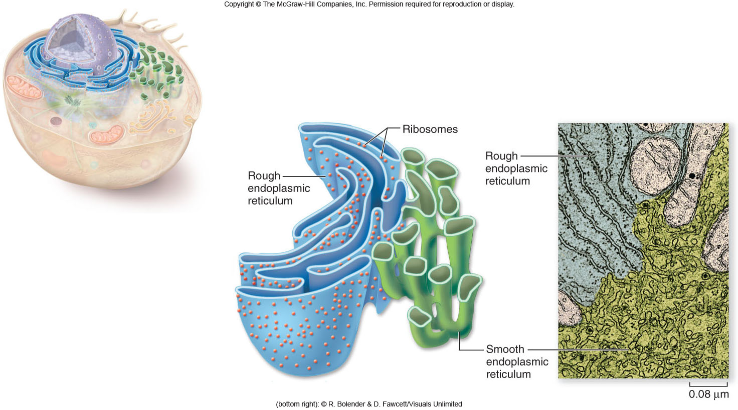
Endomembrane System

Slide 38
Endomembrane System
Golgi apparatus
flattened stacks of interconnected membranes (cisternae)
  Cis face: receives vesicles
  Trans face: ships vesicles
Functions
  packaging and distribution of materials to different parts of the cell
  synthesis of cell wall components
  produce lysosomes

Slide 39
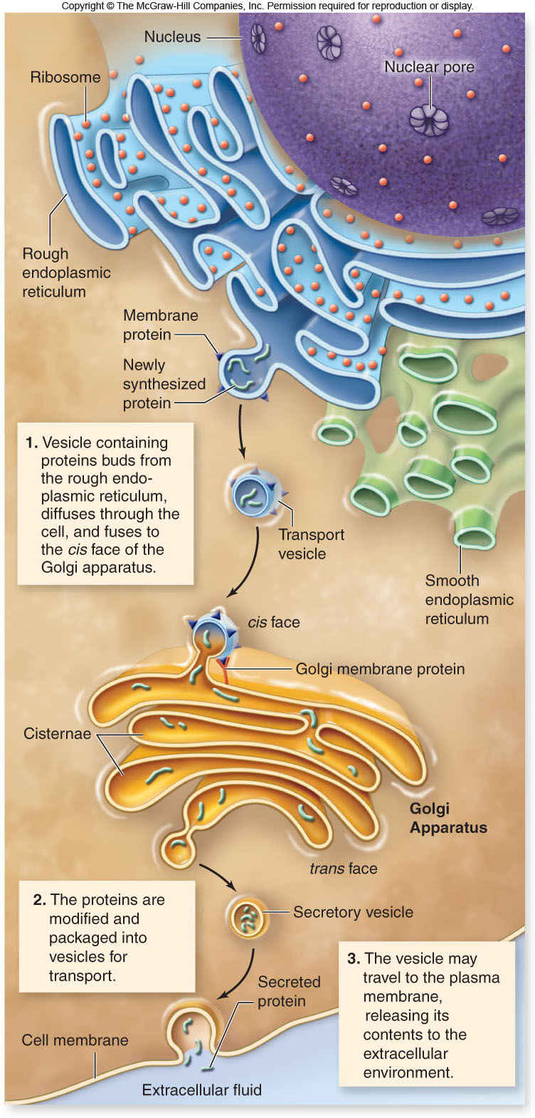
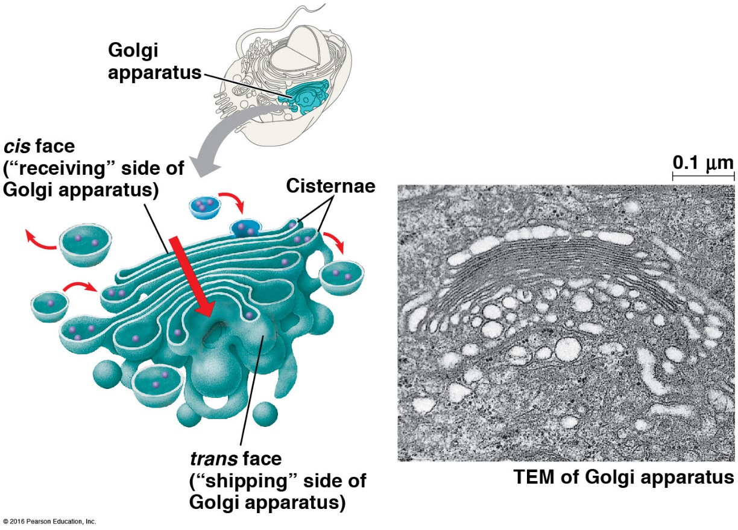

Slide 40
Endomembrane System
Lysosomes
Function:
membrane bound vesicles containing digestive enzymes (hydrolytic enzymes) to break down macromolecules
destroy cells (programmed cell death-apoptosis) or foreign matter that the cell has engulfed by phagocytosis

Slide 41
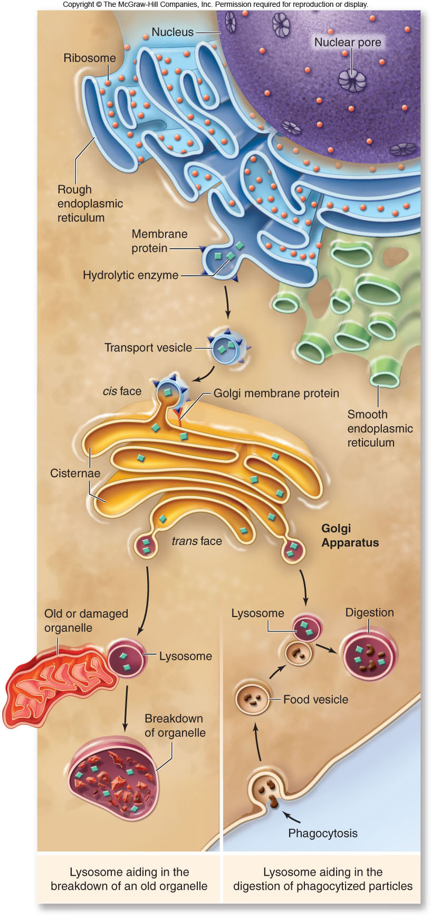
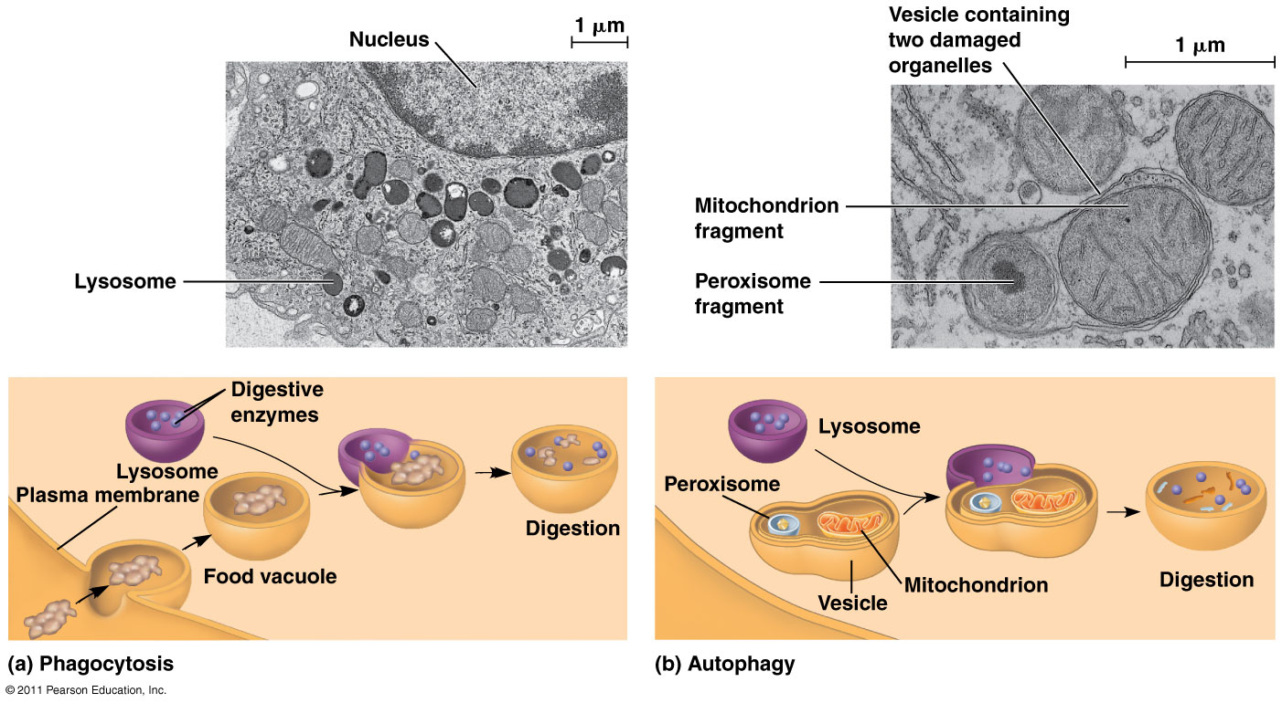

Slide 42


Slide 43
Microbodies
membrane bound vesicles
contain enzymes
glyoxysomes in plants contain enzymes for converting fats to carbohydrates
peroxisomes contain oxidative enzymes and catalase, break down fatty acids; detox alcohol, breaks down H2O2.

Slide 44
Endomembrane System
Vacuoles
membrane-bound structures with various functions depending on the cell type
There are different types of vacuoles:
central vacuole in plant cells
contractile vacuole of some protists
vacuoles for storage

Slide 45
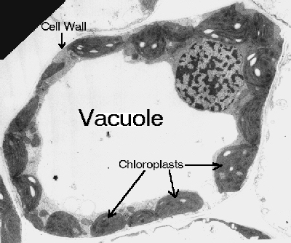
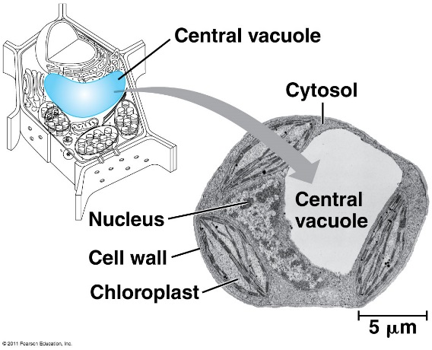
Vacuoles
Large central vacuole usually in plant cells
Many smaller vacuoles in animal cells
Storage container for water, food, enzymes, wastes, pigments, etc.
What type of microscope may have been used to take this picture?
Notes:
The image is 2D, so it must have been a light microscope or TEM. If the cell is very tiny, then a TEM was used. Otherwise, a strong light microscope could have captured this image.

Slide 46
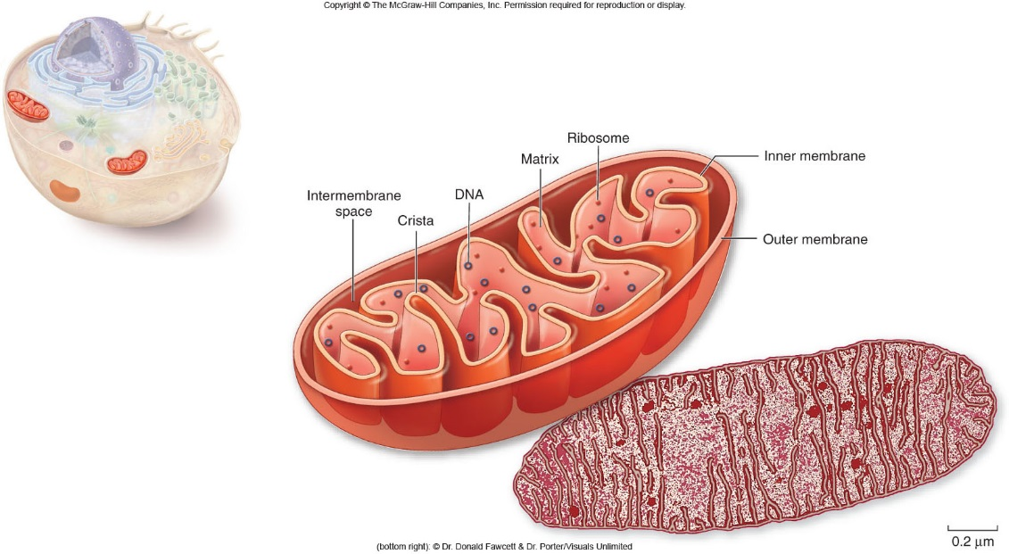
Mitochondria
organelles present in all types of eukaryotic cells
  contain their own DNA
Function: site of cellular respiration
  contain oxidative metabolism enzymes to breakdown and transform Glucose to Energy (ATP)

Slide 47
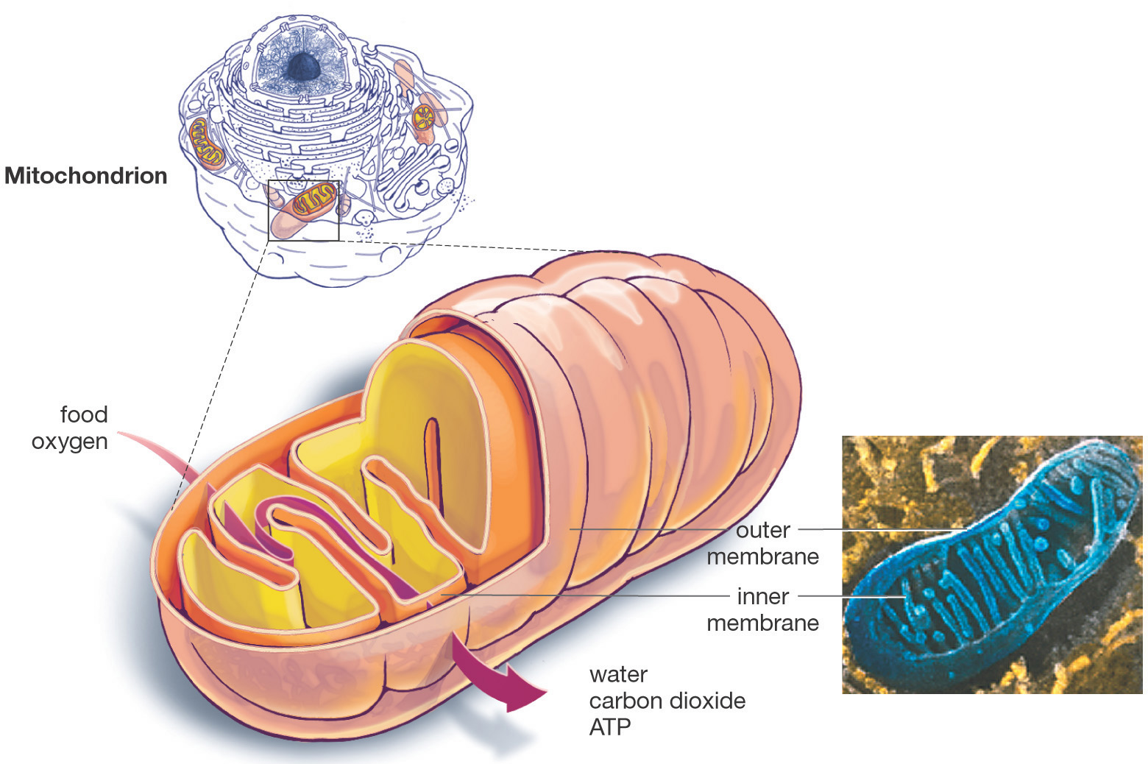
The Mitochondrion
Think of the mitochondrion as the powerhouse of the cell.
Both plant and animal cells contain many mitochondria.
(Mitochondria is the plural of mitochondrion)

Slide 48
Mitochondria
Double membrane: outer and inner membrane
smooth outer membrane
Cristae: folds of inner membrane; contains enzymes for ATP production; increased surface area to ↑ ATP made
intermembrane space is located between the two membranes
Matrix: fluid-filled inner compartment

Slide 49
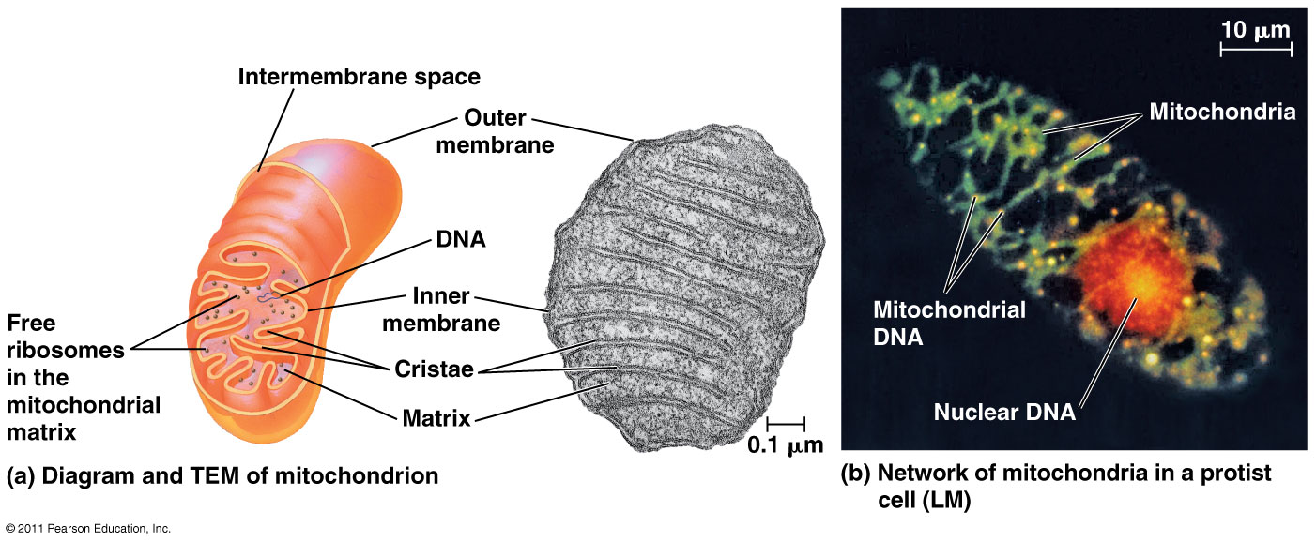

Slide 50
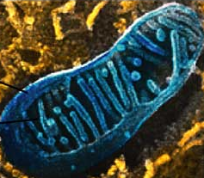
The Mitochondrion
A class of diseases that causes muscle weakness and neurological disorders are due to malfunctioning mitochondria.
Worn out mitochondria may be an important factor in aging.

Slide 51


Mitochondrial Diseases

Slide 52

Mitochondria and Health

Slide 53

Chloroplasts
Function: site of photosynthesis
  contain chlorophyll for photosynthesis
  Double membrane
thylakoids are membranous sacs within the inner membrane
grana are stacks of thylakoids

Slide 54

The Chloroplast
Think of the chloroplast as the solar panel of the plant cell.
Only plants have chloroplasts, but animals reap the benefits too.

Slide 55

Chloroplasts

Slide 56
Mitochondria & Chloroplasts
Endosymbiosis
proposal that eukaryotic organelles evolved through a symbiotic relationship
one cell engulfed a second cell and a symbiotic relationship developed
mitochondria and chloroplasts are thought to have evolved this way

Slide 57
Mitochondria & Chloroplasts
Much evidence supports this endosymbiosis theory.
Mitochondria and chloroplasts:
have 2 membranes
possess DNA and ribosomes
are about the size of a prokaryotic cell
divide by a process similar to bacteria

Slide 58


Mitochondria & Chloroplasts

Slide 59


Plastids
doubled membraned 'sac-like' organelles, generally involved in either the manufacture or storage of food
  chloroplasts, chromoplasts and leucoplasts
Chromoplasts – that produce and store pigments
  other than chloroplasts
  flowers, leaves, roots and ripe fruits
Leucoplast – starch storage

Slide 60

Cytoskeleton
network of protein fibers found in all eukaryotic cells
Function:
supports the shape of the cell
keeps organelles in fixed locations
helps move materials within the cell

Slide 61
Cytoskeleton
Cytoskeleton fibers include
actin filaments – responsible for cellular contractions, crawling, “pinching”
microtubules – provide organization to the cell and move materials within the cell
intermediate filaments – provide structural stability

Slide 62

Cytoskeleton
Acts as skeleton and muscle
Provides shape and structure
Helps move organelles around the cell
Made of three types of filaments
Notes:
Actin, also found in muscle cells, mainly help maintain cell shape in their cytoskeletal role. Microtubules mostly move organelles around the cell. Intermediate filaments also provide structural support.

Slide 63



Cytoskeleton

Slide 64
3 Types of Cytoskeleton Fibers:
Microtubules | Microfilaments | Intermediate Filaments
Protein = tubulin
Largest fibers
Shape/support cell
Track for organelle movement
Forms spindle for mitosis/meiosis
Component of cilia/flagella
Protein = actin
Smallest fibers
Support cell on smaller scale
Cell movement
Eg. ameboid movement, cytoplasmic streaming, muscle cell contraction
Intermediate size
Permanent fixtures
Maintain shape of cell
Fix position of organelles

Slide 65


Slide 66

Centriole
Centrosomes: region from which microtubules grow
  Also called microtubule organizing center
  Animal cells contain centrioles
Centrioles
Aids in cell division
Usually found only in animal cells
Made of microtubules
Notes:
Microtubules are also part of the cytoskeleton.

Slide 67
Cell Movement
Cell movement takes different forms.
Crawling is accomplished via actin filaments and the protein myosin.
Flagella undulate to move a cell.
Cilia can be arranged in rows on the surface of a eukaryotic cell to propel a cell forward.

Slide 68

Cell Movement
The cilia and flagella of eukaryotic cells have a similar structure:
9-2 structure: 9 pairs of microtubules that surround 2 central microtubules. (9-2 +2)
Cilia are usually more numerous than flagella on a cell.

Slide 69

Cell Movement

Slide 70

Extracellular Structures
Extracellular structures include:
cell walls of plants, fungi, some protists
extracellular matrix surrounding animal cells
Plasmodesmata: channels between cells to allow passage of molecules from cell to cell

Slide 71
Extracellular Structures
Cell walls
present surrounding the cells of plants, fungi, and some protists
the carbohydrates present in the cell wall vary depending on the cell type:
  plant and protist cell walls - cellulose
  fungal cell walls - chitin

Slide 72

Extracellular matrix (ECM)
surrounds animal cells
composed of glycoproteins and fibrous proteins such as collagen
may be connected to the cytoplasm via integrin proteins present in the plasma membrane

Slide 73

Extracellular Structures

Slide 74

Intercellular Junctions (Animal cells)
Tight junctions: 2 cells are fused to form watertight seal
Desmosomes: “rivets” that fasten adjacent cells into strong sheets
Gap junctions: channels through which ions, sugar, small molecules can pass

Slide 75

Some functions of membrane proteins

Slide 76
Cell Membrane
Plasma membrane is selectively permeable
  Allows some substances to cross more easily than others
    hydrophobic (nonpolar) vs. hydrophilic (polar)
  Cell membrane separates living cell from aqueous environment
Fluid Mosaic Model
  Fluid: membrane held together by weak interactions
  Mosaic: phospholipids, proteins, carbs

Slide 77

Fluid Mosaic Model

Slide 78


Phospholipids
Phosphate
Phosphate head
  hydrophilic
Fatty acid tails
  hydrophobic
Arranged as a bilayer
Amphipathic = hydrophilic head, hydrophobic tail
“attracted to water”
Fatty acid
“repelled by water”
Aaaah,
one of those
structure–function
examples

Slide 79

Arranged as a Phospholipid bilayer
Serves as a cellular barrier / border
sugar
H₂O
salt
polar
hydrophilic
heads
nonpolar
hydrophobic
tails
impermeable to polar molecules
polar
hydrophilic
heads
waste
lipids

Slide 80

Permeability to polar molecules?
Membrane becomes semi-permeable via protein channels
  specific channels allow specific material across cell membrane
inside cell
H₂O
aa
sugar
salt
outside cell
NH₃

Slide 81
Why are
proteins the perfect
molecule to build structures
in the cell membrane?

Slide 82

Transmembrane protein structure
Hydrophobic interior
Hydrophilic ends

Slide 83

Membrane fluidity
Low temps: phospholipids w/unsaturated tails (kinks prevent close packing)
Cholesterol resists changes by:
  limit fluidity at high temps
  hinder close packing at low temps

Slide 84
Evolution of Differences in Membranes
Variations in lipid composition of many species
  adaptations to specific environmental conditions
  arctic fish → high proportion of unsaturated tails
  plants in winter → % unsaturated tails increases in autumn (winter wheat)
  bacteria in hot springs – unusual lipids
Natural Selection

Slide 85
Membrane Proteins
Integral Proteins
Peripheral Proteins
Embedded in membrane
Determined by freeze fracture
Transmembrane with hydrophilic heads/tails and hydrophobic middles
ex: transport proteins
  channels, permeases (pumps)
Extracellular or cytoplasmic sides of membrane
NOT embedded, loosely bound
Held in place by the cytoskeleton or ECM
Provides stronger framework
antigens

Slide 86

Peripheral proteins: surface
Cell-surface proteins : Medical Field
  Ex: HIV must bind to the immune cell-surface protein CD4 and a “co-receptor” CCR5 in order to infect a cell
  HIV can’t enter the cells that lack CCR5
  Drugs are now being developed to mask the CCR5 protein

Slide 87

Carbohydrates
Function: cell-cell recognition; developing organisms
Glycolipids, glycoproteins
  ability of a cell to distinguish one cell from another
    antigens
important in organ & tissue development
basis for rejection of foreign cells by immune system
  Eg. blood transfusions are type-specific

Slide 88
Harvard cell video
http://multimedia.mcb.harvard.edu/anim_innerlife.html

Slide 89



Slide 90


Slide 91



Slide 92


Slide 93


Slide 94


Slide 95
Eukaryotic Cells
A. holes
B.
O. Dot in middle
C.
N.
D. dots
M.
L.
K. “empty space”
J. Digesting material
E. Taking material into cell
F.
I.
G. Folds
H.

Slide 96
Eukaryotic Cells
L.
M. Whole purple structure
K.
A. Stuff in the middle
B.
C.
D.
J. Outer layer
G. Whole structure
H. Stacks
I. Each disk
F. Outer layer
E. Channel

Slide 97

B
C
D
A
E
F
O
N
G
M
L
H
I
K
J

Slide 98

A
B
C
O
N
D
M
E
L
F
K
J
I
G
H

